Slide 1

Predicting Heart Disease Risk: Analyzing Health and Socio-Economic Indicators (Final project) Aisha Mohammad

Slide 2

Contents:
Problem statement
Literature review
Literature review - Zotero
High level diagram
Data acquisition
MVP
Data pre processing
INFLUENCE OF socio-economic disparities
Model training and evaluation
Model comparison and summary
Feature importance of best model.
Challenges and limitations
Future work
Links

Slide 3
PROBLEM STATEMENT
Heart disease remains a leading global health concern, however, the impact of socioeconomic factors like income, education, race, and gender on heart disease risk is often underexplored.
This project aims to conduct an in-depth prediction of heart disease risk by examining both clinical health indicators and socioeconomic determinants and develop predictive models to identify individuals at risk.
These findings will help inform public health strategies, optimize resource allocation, and address health inequities in heart disease prevention and management.

Slide 4
LITERATURE REVIEW
Scope: Articles from journals dating from 2019-2024 have been studied.
Relevance: These articles are all related to heart disease prediction and significance of socio-econimic determinants of health.
Objective: The studies aim to predict heart disease using various techniques such as ML algorithms, EDA, DL neural networks, Visualizations and feature selection. Diverse datasets were used to perform these analysis.
A 3 page detailed literature review was created by doing a carreful literature survey.

Slide 5
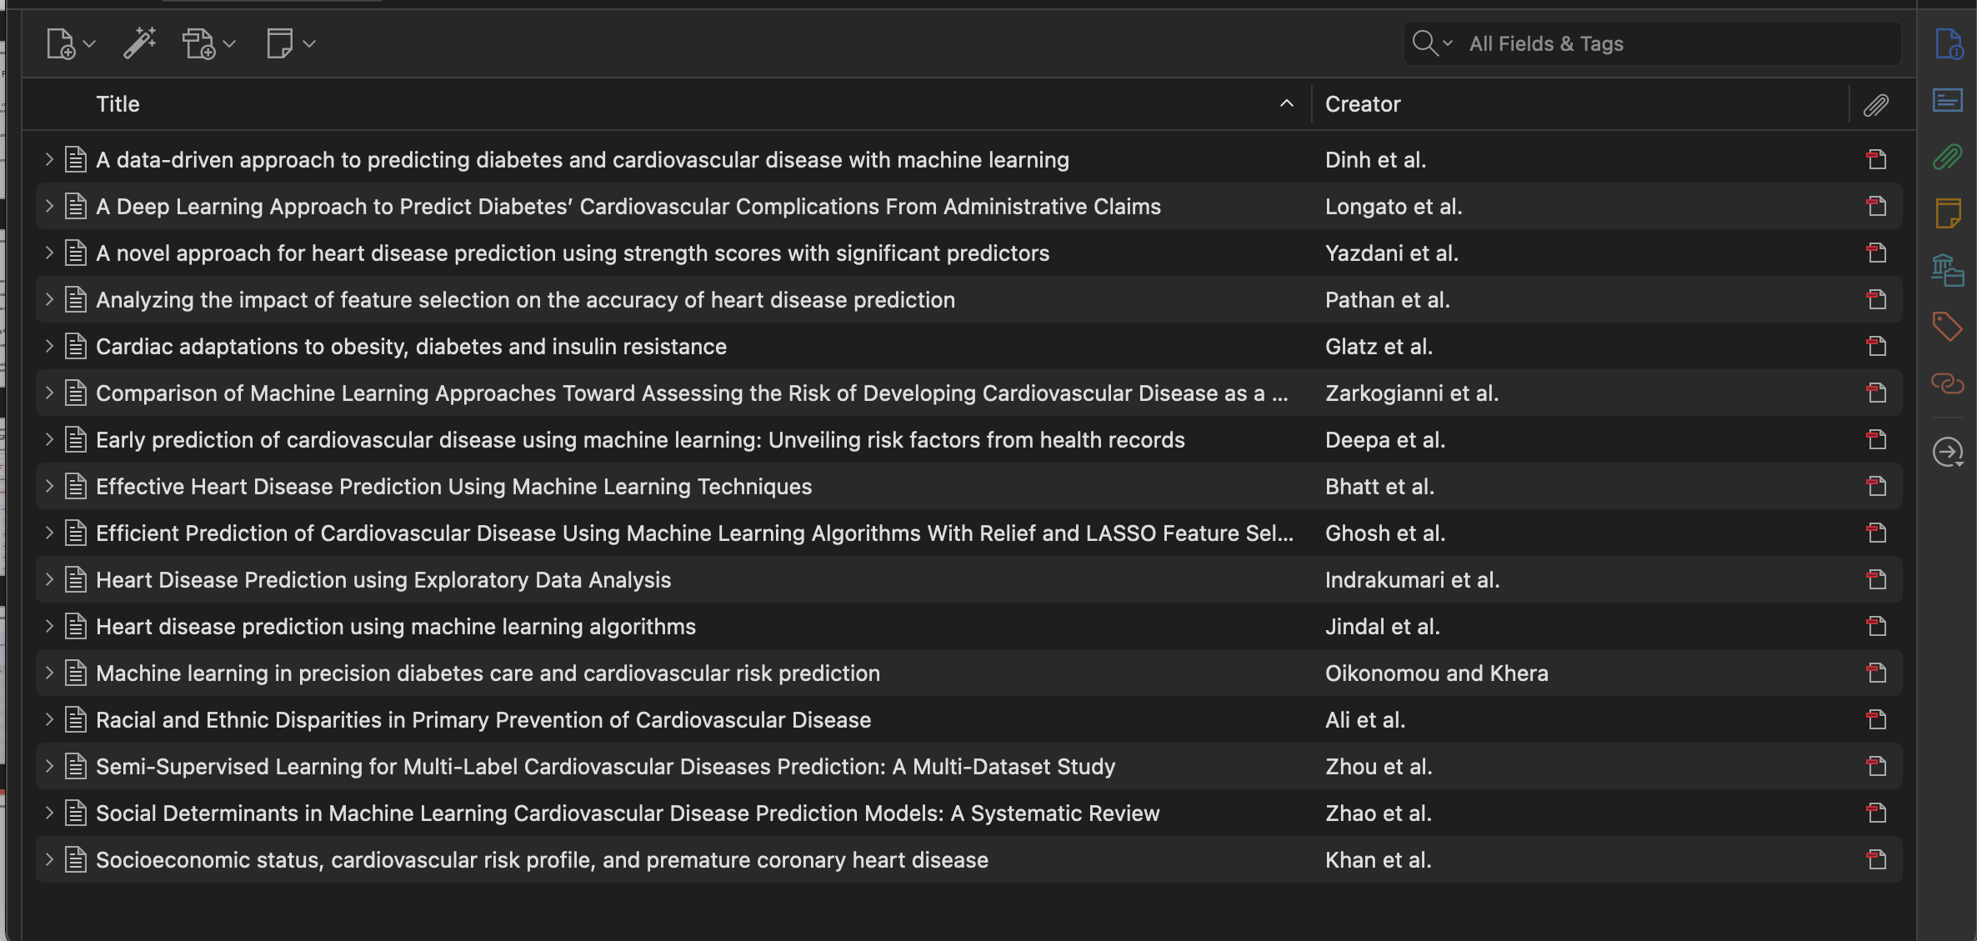
Literature articles - Zotero

Slide 6
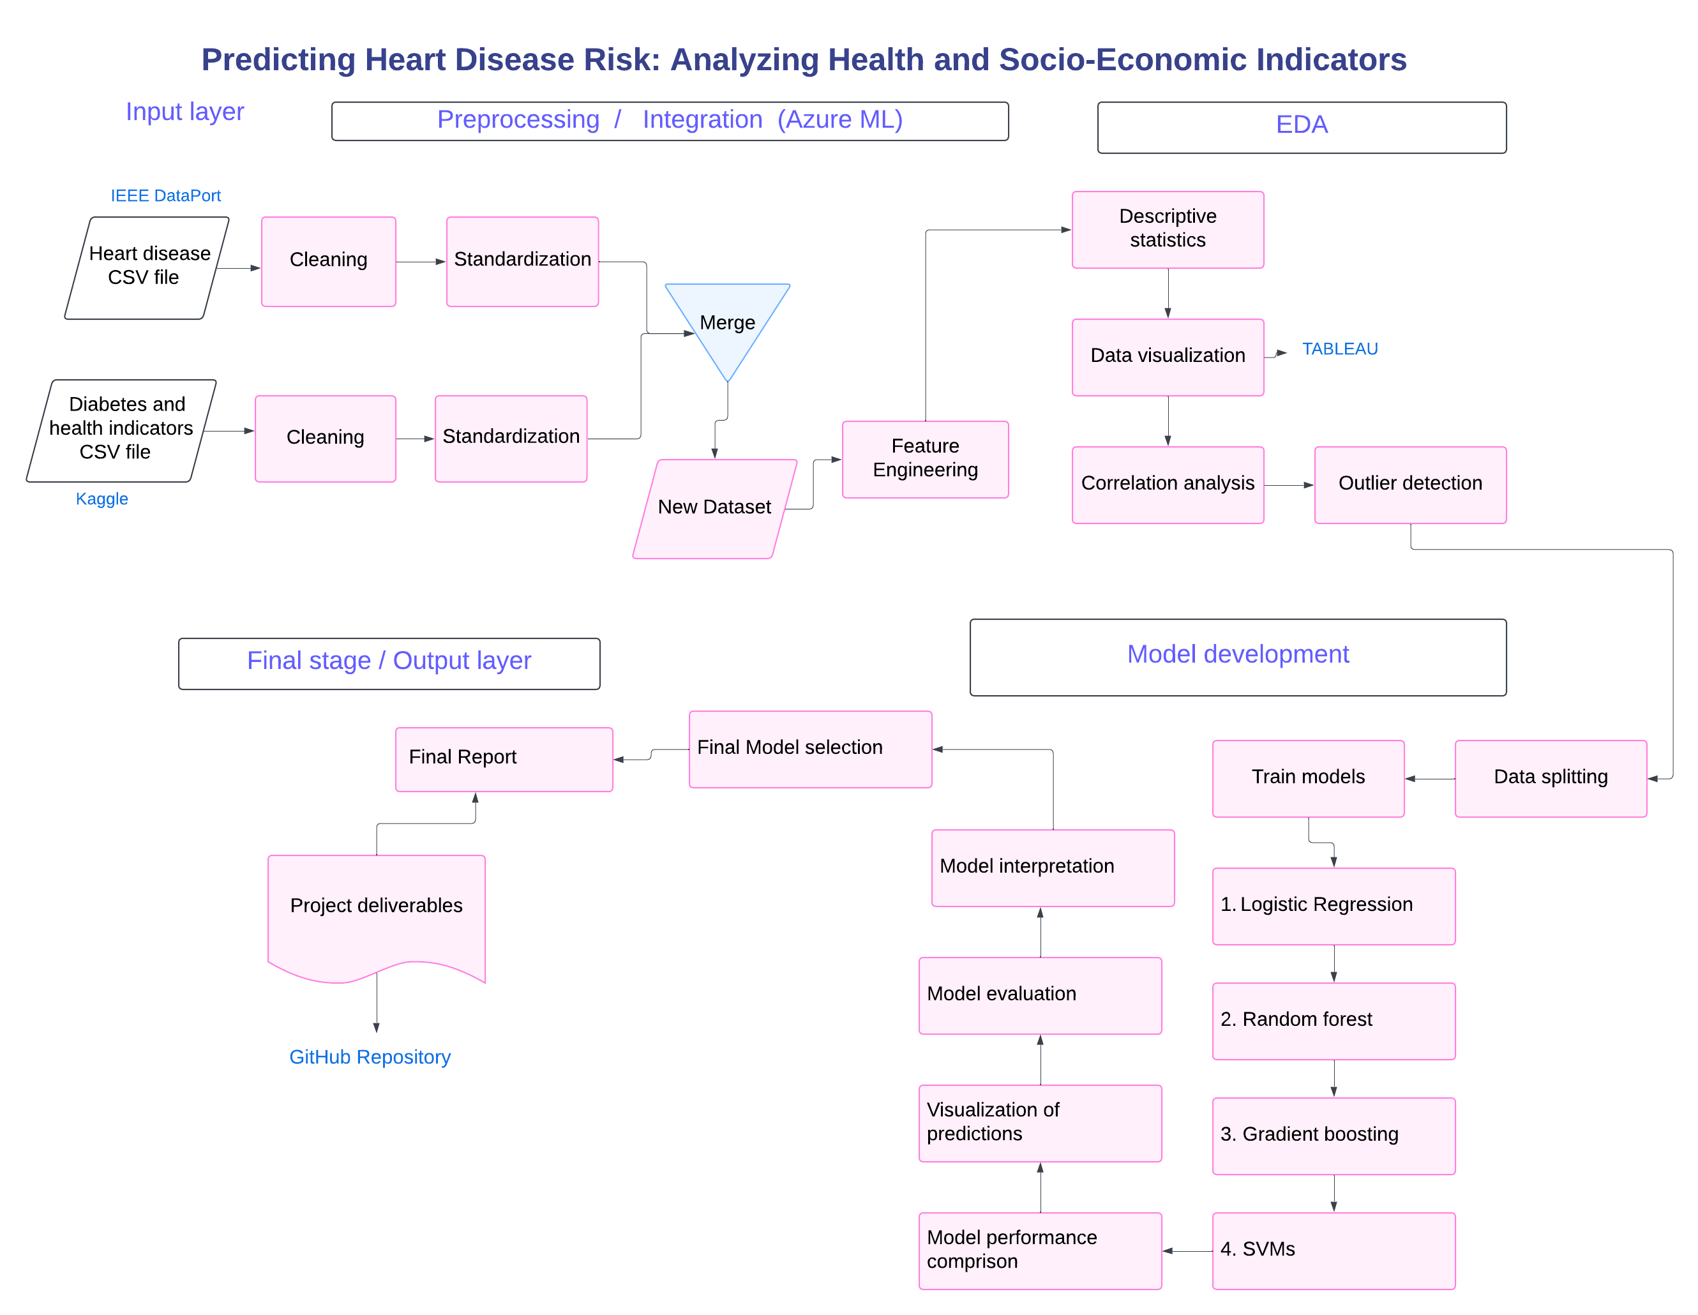

Slide 7
Data justification
Diabetes Binary Health Indicators Dataset
Source: Kaggle (2015 BRFSS, CDC)
Shape: 253,680 survey responses, 22 features
Heart Disease Comprehensive Dataset
Source: IEEE DataPort (Manu Siddhartha)
Shape: 1190 samples, 12 features
Combined Dataset:
New Dataset Name: ‘combined_heart_lifestyle_dataset.csv’
Features: 34 features, 1190 entries
Key Steps:
Merged diabetes, socio-economic, and heart disease data.
SMOTE applied for balancing the new target variable.
Data quality check: Missing values, duplicates handled.
Target variable engineered by merging relevant features.

Slide 8
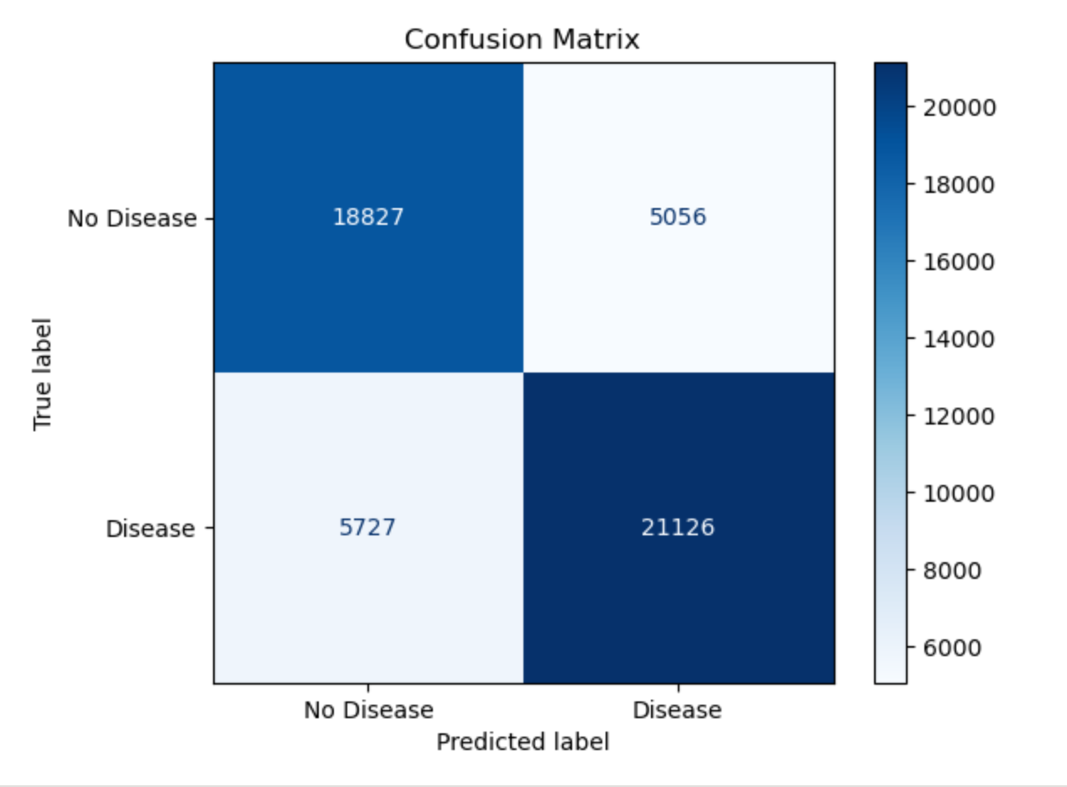
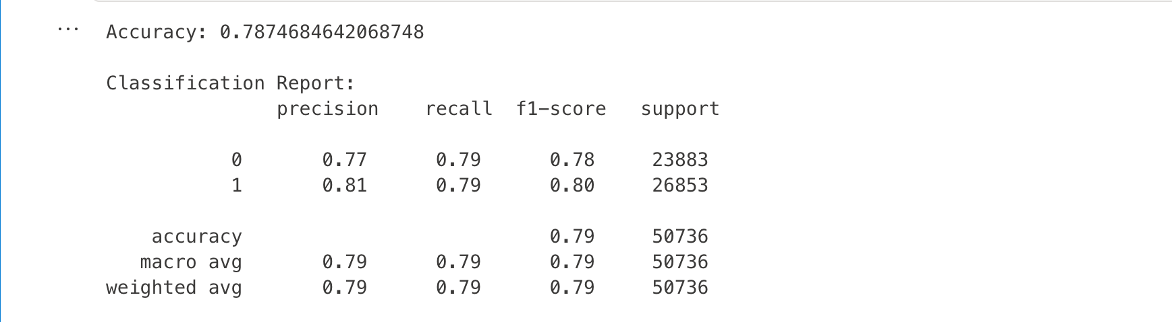
MVP
Data preprocessing:
Did Standard scaling for numerical data and combined both datasets into a new dataset called ‘combined’.
Dropped similar columns and columns with numerical data for simpler model development
Model selection: Logistic regression was applied on ‘combined’ as it works well with binary data.
Model Performance: The model achieves an accuracy of ~79%, which is reasonable for a binary classification problem.
This confusion matrix shows the performance of a model predicting Disease vs. No Disease:
True Negatives (TN): 18,827 correctly predicted No Disease.
False Positives (FP): 5,056 incorrectly predicted as Disease.
False Negatives (FN): 5,727 incorrectly predicted as No Disease.
True Positives (TP): 21,126 correctly predicted Disease.

Slide 9
Data pre processing
Tecnhniques applied for data pre processing :
Feature Scaling: Standardized numerical features (age, cholesterol, BMI, etc.) for normalization.
Feature Engineering: Merged ‘Target’ and ‘HeartDiseaseorAttack’ into a new target variable.
Imbalanced Data Handling: Applied SMOTE to balance the target variable.
Feature Selection: Used 4 methods to identify key features:
Correlation Matrix
Point-Biserial Correlation
Random Forest Classifier
Recursive Feature Elimination (RFE) with Logistic Regression
Selected features aligned with socio-economic factors from Random Forest Classifier results , while irrelevant ones were dropped.

Slide 10
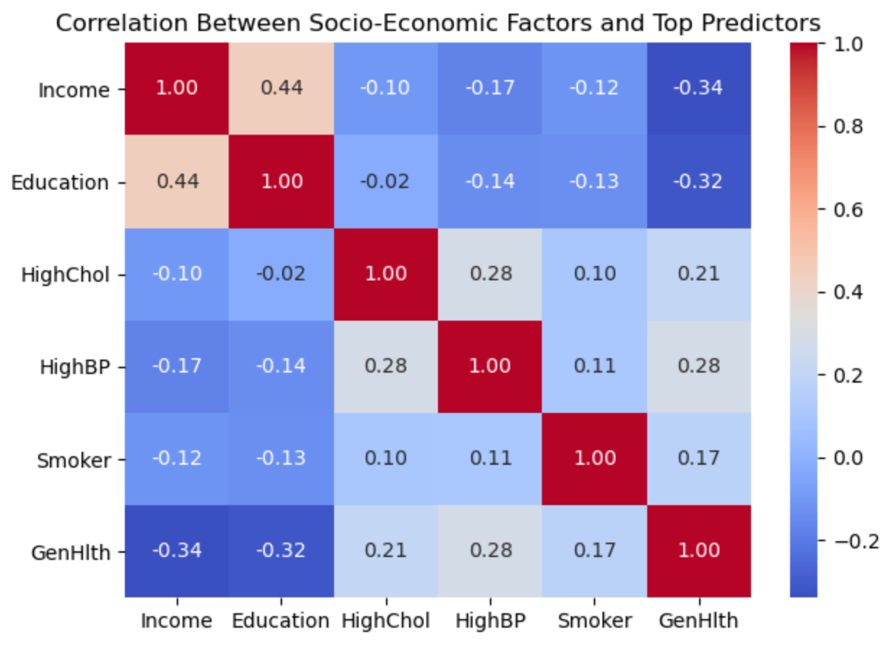
INFLUENCE OF socio-economic disparities
Income and General Health have a negative correlation (-0.34), suggesting lower income is associated with poorer health.
Education and General Health also show a negative correlation (-0.32).
This suggests an indirect influence of socio economic factors on heart disease prediction.

Slide 11
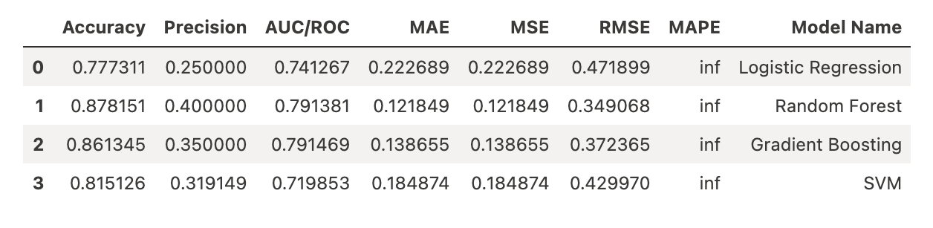
MODEL TRAINING and evaluation
Size of X train and Y train(1453, 20) (1453,)respectively.
Y train is balanced at 855 (0) and 855 (1).
Size of X_test and Y_test are (238, 20) (238,)respectively.
4 models trained.
Evaluation metrics : Accuracy, Precision, AUC/ROC, MAE, MSE, RMSE, MAPE.

Slide 12
MODEL COMPARISION & best model SUMMARY
Best Model is the Random Forest with highest accuracy: 87.81% and best AUC/ROC: 79.13%.
Gradient Boosting performs similarly (86.13% accuracy) but has a slightly lower AUC/ROC.
Logistic Regression & SVM underperform, with lower accuracy and precision.
Error Metrics (MAE, MSE, RMSE) are lowest for Random Forest, confirming its reliability.
MAPE is infinite (∞) due to potential zero values in the denominator.
Best Model: Random Forest
Highest Accuracy: 87.81%%
Best AUC/ROC: 79.13% (better ability to distinguish between classes)
Lowest Error Metrics (MAE, MSE, RMSE): Indicating better overall predictions
Higher Precision (0.4286) than Logistic Regression & SVM

Slide 13
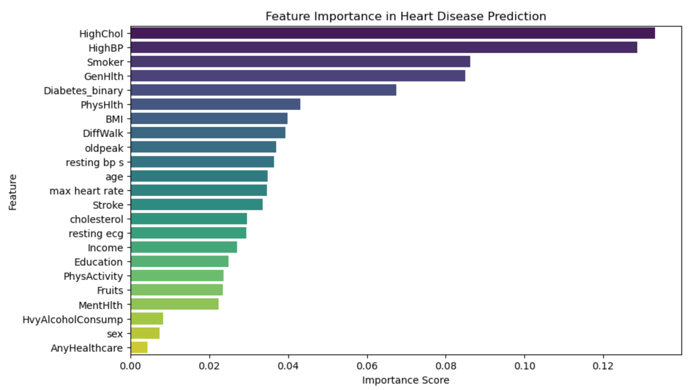
FEATURE IMPORTANCE OF BEST MODEL
Top Factors: High Cholesterol, High Blood Pressure, Smoking, and General Health are the strongest predictors.
Moderate Impact: Diabetes, BMI, Difficulty Walking, Age, and Resting Blood Pressure contribute significantly.
Lower Impact: Income and Education have relatively low importance, suggesting socioeconomic factors may not be direct indicators of heart disease risk.
Least Important: Sex, Alcohol Consumption, and Access to Healthcare show minimal influence.

Slide 14
STREAMLIT APP RECORDING LINK
HEART DISEASE PREDICTION STREAMLIT APP RECORDING

Slide 15
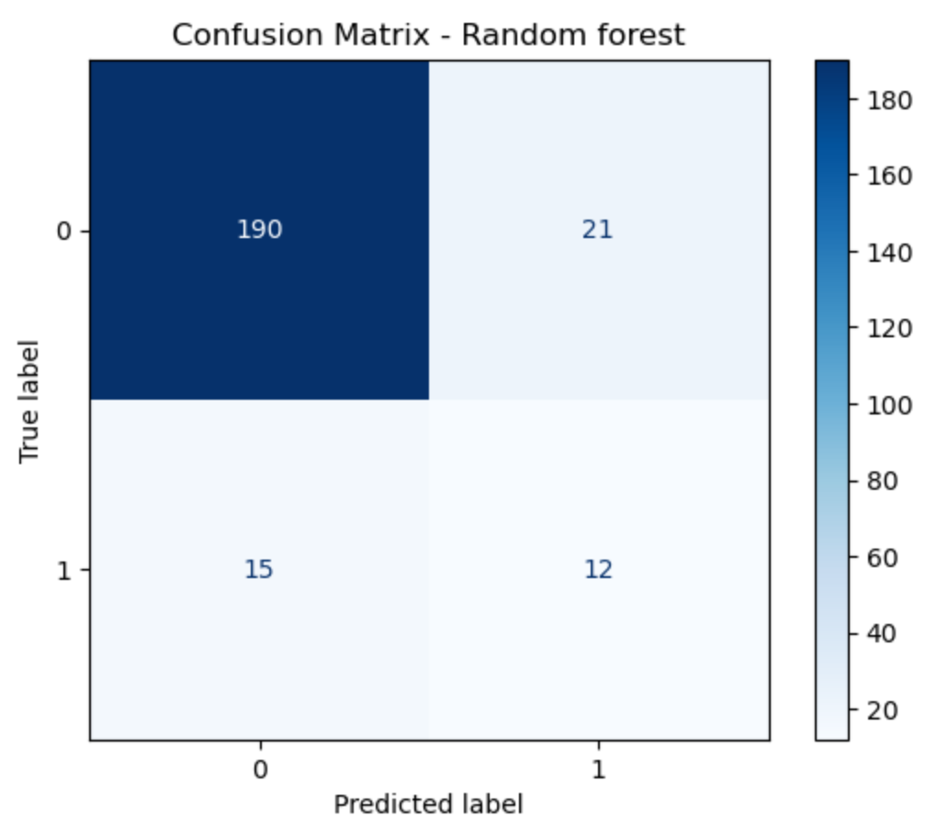
CHALLENGES & LIMITATIONS
Model Bias in Predictions
Despite extensive efforts, including SMOTE for balancing, multiple feature selection techniques, and different preprocessing methods, the model consistently predicts a higher bias for no heart disease (0)’.
Streamlit App Prediction Issue
Successfully built the Streamlit app, but despite multiple debugging attempts, it only predicts ‘Low risk of heart disease’ (0).
Verified training data balance (0 and 1 equally represented), yet the deployed model remains biased, likely due to decision boundary issues or feature influence.
Despite being the best-performing model, the confusion matrix reveals -
Low recall for positive class (1), indicating bias.
Occurs despite balancing with SMOTE

Slide 16
Future work
Improve dataset concatenation for better data integration.
Investigate potential issues arising from merging target variables.
Apply advanced techniques to uncover stronger relationships and trends.
Explore additional feature selection methods to enhance model accuracy.
Address bias and imbalance issues in model predictions.

Slide 17
Tools :-
LINKS:-
Zotero
GitHub
Azure ML – notebooks
Jira – Gantt chart
VS CODE
Streamlit
MVP code Capstone MVP.ipynb - Azure Machine Learning
Capstone project code Capstone.ipynb - Azure Machine Learning
GitHub https://github.com/Aisha-datatech/Capstone-Project.git
Jira
https://saintpeters-team-hisfhzp1.atlassian.net/jira/core/projects/DTP/timeline?rangeMode=weeks&atlOrigin=eyJpIjoiZTI2YzQwYWQ4ZjcwNGY1ZWIyMGQ2YzU0YWY0NzRlYjEiLCJwIjoiaiJ9

